Slide 1
M SAKTHIVEL
Bachelor of technology
Artificial intelligence & data science
211521243132
3/21/2024 Annual Review

Slide 2
TITLE
Song Lyrics Generator
3/21/2024 Annual Review

Slide 3


AGENDA
Introduction
Project Overview Implementation Details Additional Processes Demonstration Conclusion & Discussion
3/21/2024 AnnualReview
3

Slide 4

PROBLEM
STATEMENT
Crafting compelling and meaningful song lyrics can be a challenging task for artists, often requiring inspiration, creativity, and a deep understanding of musical themes and emotions. Traditional methods of lyric writing may be time-consuming and may not always yield satisfactory results.
3/21/2024 Annual Review

Slide 5

PROJECT
OVERVIEW
This project
aims to address the
by
challenges faced by songwriters
leveraging deep learning techniques to generate lyrics that capture the essence and emotional tone of different musical genres. By analyzing large datasets of song lyrics and training neural network models, the system will be able to generate lyrics that align with specific themes, moods, and musical styles.
3/21/2024 Annual Review

Slide 6

WHOARE THE END USERS?
The end users of this system include musicians, songwriters, bands, music producers, and anyone interested in exploring creative writing in the context of song lyrics. Additionally, the system could be integrated into music composition software and digital audio workstations (DAWs) to enhance the songwriting process.
3/21/2024 Annual Review

Slide 7

YOUR SOLUTIONAND ITS VALUE PROPOSITION
The proposed solution involves training Recurrent Neural Network (RNN) models, specifically Long Short-Term Memory (LSTM) networks, on a diverse collection of song lyrics from various artists and genres. These models will learn the patterns, structures, and
themes types of
prevalent songs
in different and will be
capable of generating new lyrics
based on user-defined
3/21/2024 Annual Review
7
parameters such as genre mood

Slide 8

THE WOW IN YOUR SOLUTION
The wow factor of this project lies in its ability to generate original
and stylistically lyrics that
consistent song
resonate with the
and
chosen musical genre
thematic content. By harnessing the power of deep learning, the
system sources
can provide endless of inspiration and
creativity for songwriters, enabling
them to explore new ideas and perspectives in their songwriting
3/21/2024 AnnualReview
8

Slide 9
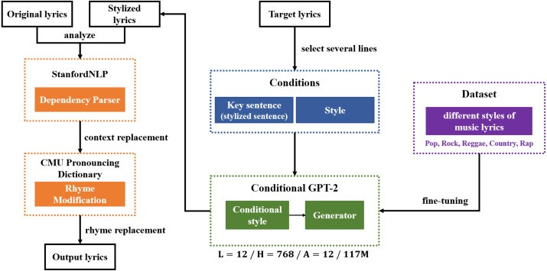
MODELLING
3/21/2024 A
nn
ualReview

Slide 10
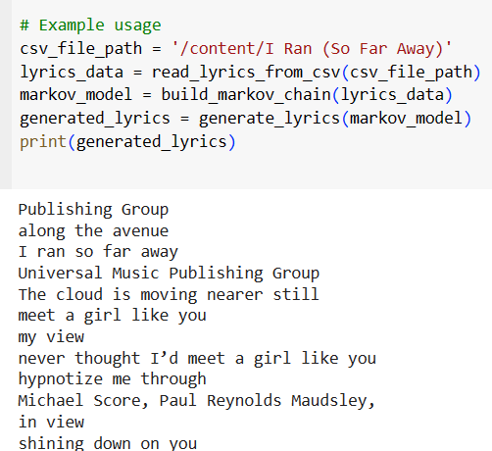
RESULTS
Demo Link
3/21/2024 A
nn
ualReview

